Slide 1
MODULE two: profiling
Speaker, Date
Notes:
Screenshots are all taken from PGI/PGPROF on Ubuntu 16.04
Feel free to use any profiler that you prefer.

Slide 2
Module OVERVIEW
Topics to be covered
Compiling and profiling sequential code
Explanation of multicore programming
Compiling and profiling multicore code
Notes:
This Module was originally designed for the PGI compiler.

Slide 3
Compiling sequential code
Notes:
Simply how to compiler C/C++ code. For the most part, students will be able to use Makefiles for lab exercises, and do not have to worry about compiling the codes themselves.

Slide 4
PGI Compiler Basics
pgcc, pgc++ and pgfortran
The command to compile C code is ‘pgcc’
The command to compile C++ code is ‘pgc++’
The command to compile Fortran code is ‘pgfortran’
The -fast flag instructs the compiler to optimize the code to the best of its abilities
$ pgcc –fast main.c
$ pgc++ -fast main.cpp
$ pgfortran –fast main.F90

Slide 5
PGI Compiler Basics
-Minfo flag
The Minfo flag will instruct the compiler to print feedback about the compiled code
-Minfo=accel will give us information about what parts of the code were accelerated via OpenACC
-Minfo=opt will give information about all code optimizations
-Minfo=all will give all code feedback, whether positive or negative
$ pgcc –fast –Minfo=all main.c
$ pgc++ -fast -Minfo=all main.cpp
$ pgfortran –fast –Minfo=all main.f90
Notes:
-Minfo=accel will only show any feedback if there are OpenACC optimizations.
-Minfo=opt will give us a lot of information regarding optimizations (this includes non-parallel optimizations as well!)
-Minfo=all will give more feedback, and will even give feedback about the sequential code. It can be overwhelming for individuals who are not used to things such as loop unrolling, or fused instructions. It will also give negative feedback (where code couldn’t be optimized, for example)

Slide 6
GCC Compiler Basics
gcc, gc++ and gfortran
The command to compile C code is ‘gcc’
The command to compile C++ code is ‘g++’
The command to compile Fortran code is ‘gfortran’
The -O2 flag sets the optimization level to 2 (a safe starting point)
$ gcc -O2 main.c
$ g++ -O2 main.cpp
$ gfortran -O2 main.F90

Slide 7
GCC Compiler Basics
Compiler feedback
The -fopt-info flag will print limited compiler feedback
The -flto-report flag will also print link-time optimizations, but should be used sparingly due to volume of information
$ gcc -O2 –fopt-info main.c
$ g++ -O2 –fopt-info main.cpp
$ gfortran -O2 –fopt-info main.f90
Notes:
-Minfo=accel will only show any feedback if there are OpenACC optimizations.
-Minfo=opt will give us a lot of information regarding optimizations (this includes non-parallel optimizations as well!)
-Minfo=all will give more feedback, and will even give feedback about the sequential code. It can be overwhelming for individuals who are not used to things such as loop unrolling, or fused instructions. It will also give negative feedback (where code couldn’t be optimized, for example)

Slide 8
Profiling sequential code
Notes:
Running sequential code before any code edits to get baseline results.

Slide 9
Openacc development CYCLE
Analyze your code to determine most likely places needing parallelization or optimization.
Parallelize your code by starting with the most time consuming parts, check for correctness and then analyze it again.
Optimize your code to improve observed speed-up from parallelization.
Analyze
Analyze
Optimize
Parallelize
Notes:
This is the OpenACC development cycle. Analyze -> Parallelize -> Optimize. Rinse and repeat. It is slightly over-simplified, however. It is very important to profile you code before beginning, however, it is equally important to continue profiling your code as you make changes. It is important to verify that changes you are making are impacting the code in a way that you expected.
The Modules are designed to follow this format. This Module will include the Analyze portion. We are expecting students to profile for every module, however.

Slide 10
Profiling sequential code
Step 1: Run Your Code
Terminal Window
Record the time it takes for your sequential program to run.
$ pgcc –fast jacobi.c laplace2d.c
$ ./a.out
0, 0.250000
100, 0.002397
200, 0.001204
300, 0.000804
400, 0.000603
500, 0.000483
600, 0.000403
700, 0.000345
800, 0.000302
900, 0.000269
total: 39.432648 s
Note the final results to verify correctness later.
Always run a problem that is representative of your real jobs.
Notes:
3 main takeaways from this slide:
We need to know the application runtime to compare against later. If the program doesn’t have built-in timers the UNIX time command can be used, but in real applications this is often not representative of the important part of the code because it include initial, one-time setup and teardown. It’s best to add a timer around the core of the program, such as a timestepping loop.
Running faster doesn’t matter if your answers aren’t correct. Get a baseline of what the expected results are so that at each step you can verify that your changes still produce correct results.
You want to run a problem that executes fairly quickly, but it still needs to be realistic. For instance, we don’t want to cut back the size of our computation, but we may want to reduce the number of steps. Running a significantly smaller problem may emphasize different parts of the code than a full problem, leading to wasted effort.

Slide 11
Profiling sequential code
Step 2: Profile Your Code
Sample Code: Conjugate Gradient
Obtain detailed information about how the code ran.
Total Runtime: 22.38 seconds
This can include information such as:
Total runtime
Runtime of individual routines
Hardware counters
The “matvec” function is our dominate hotspot
Identify the portions of code that took the longest to run. We want to focus on these “hotspots” when parallelizing.
Notes:
The chart is from another sample code, one that the students are not expected to work with. We will create a similar graph with our lab code once we explain the profiling process.

Slide 12
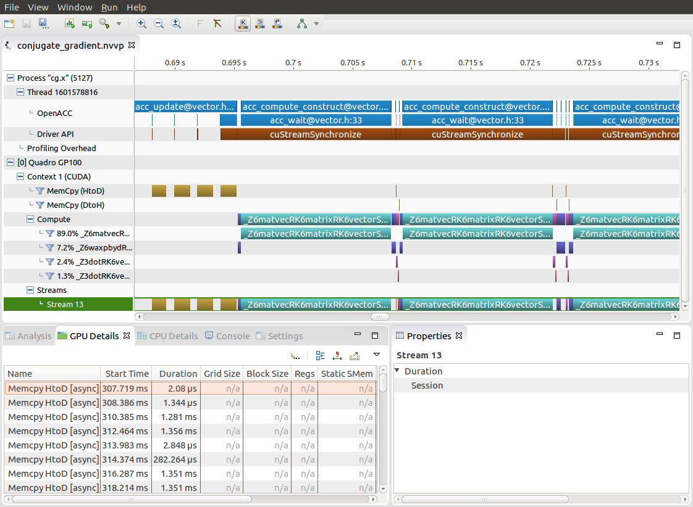
Profiling sequential code
Introduction to PGProf
Gives visual feedback of how the code ran
Gives numbers and statistics, such as program runtime
Also gives runtime information for individual functions/loops within the code
Includes many extra features for profiling parallel code
Notes:
The profiler will gives us feedback of which portions of our code we should focus on. (the most time consuming)
When we start parallelizing our program (especially if using a GPU) the profiler will give us a lot of extra information, such as a visual timeline, occupancy, data movement, etc.

Slide 13
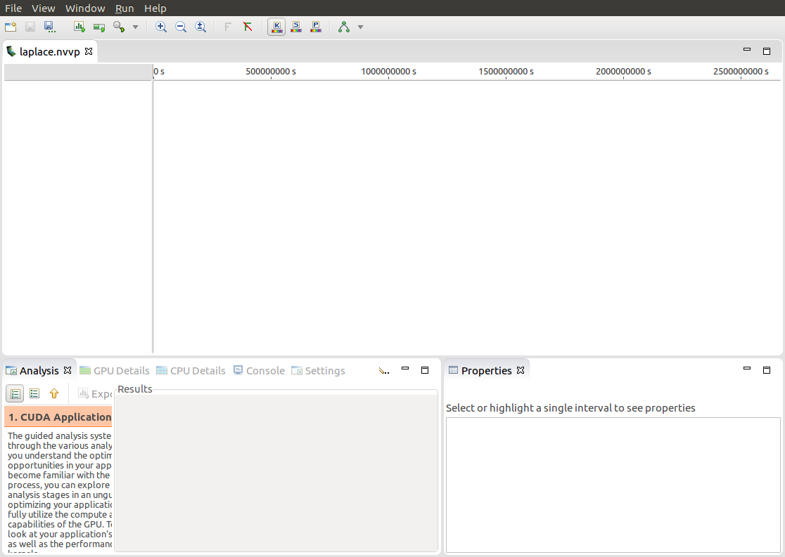
Profiling sequential code
First sight when using PGPROF
Profiling a simple, sequential code
Our sequential program will on run on the CPU
To view information about how our code ran, we should select the “CPU Details” tab
Notes:
This is what you’re greeted with when opening an executable in PGPROF. The screenshots will be of the laplace lab code, so when students go through the lab, they should see very similar results.
Since we are running the code sequentially, only the CPU will be active. We can select “CPU Details” to view additional information about the CPU.

Slide 14
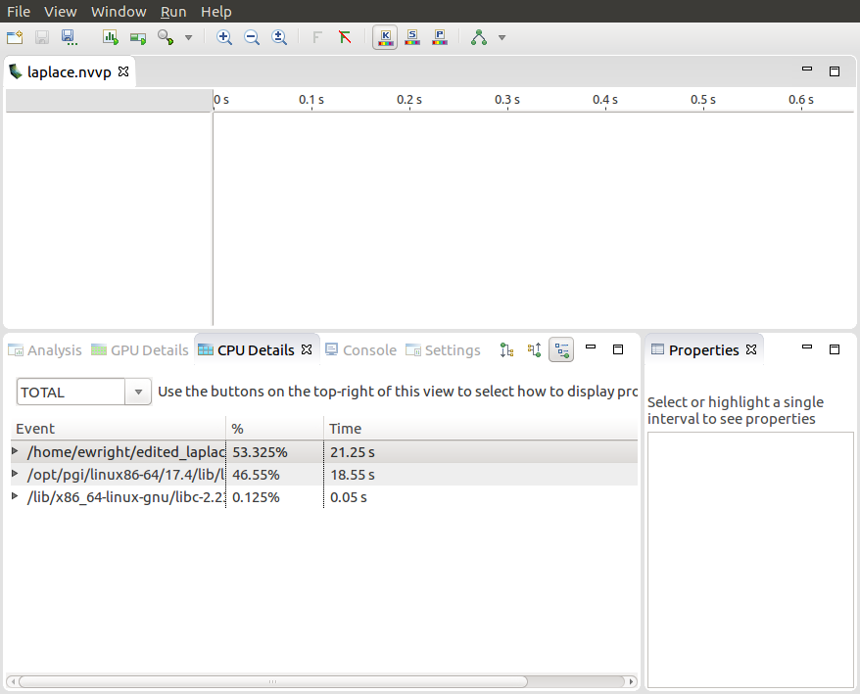
Profiling sequential code
CPU Details
Within the “CPU Details” tab, we can see the various parts of our code, and how long they took to run
We can reorganize this info using the three options in the top-right portion of the tab
We will expand this information, and see more details about our code
Notes:
This is a view of the CPU details, where we can see which parts of our code took the longest to run, and how long each portion took. I have highlighted a few options in the top-left hand corner of the CPU Details window, these are different views, and will display the CPU Details in a different way.

Slide 15
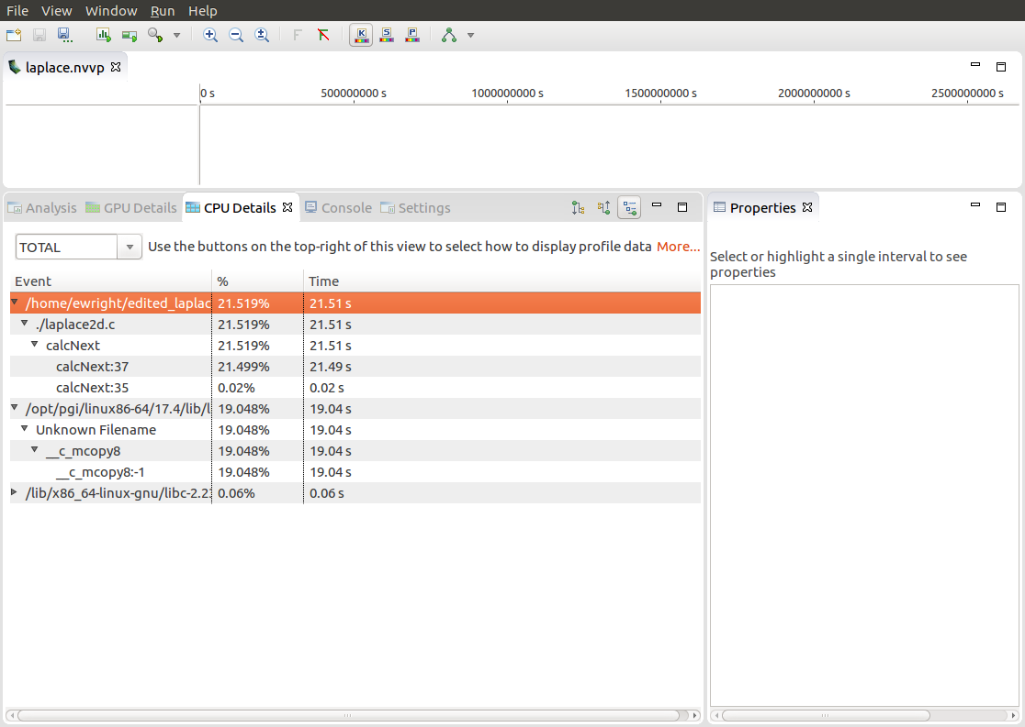
Profiling sequential code
CPU Details
We can see that there are two places that our code is spending most of its time
21.49 seconds in the “calcNext” function
19.04 seconds in a memcpy function
The c_mcopy8 that we see is actually a compiler optimization that is being applied to our “swap” function
Notes:
We are seeing that the majority of our program is spend in a function called “calcNext” and “__c_mcopy8”
The calcNext is our code from the laplace code, while the __c_mcopy8 is a memory copy. We can also see that the calcNext takes slightly longer than the memcpys.

Slide 16
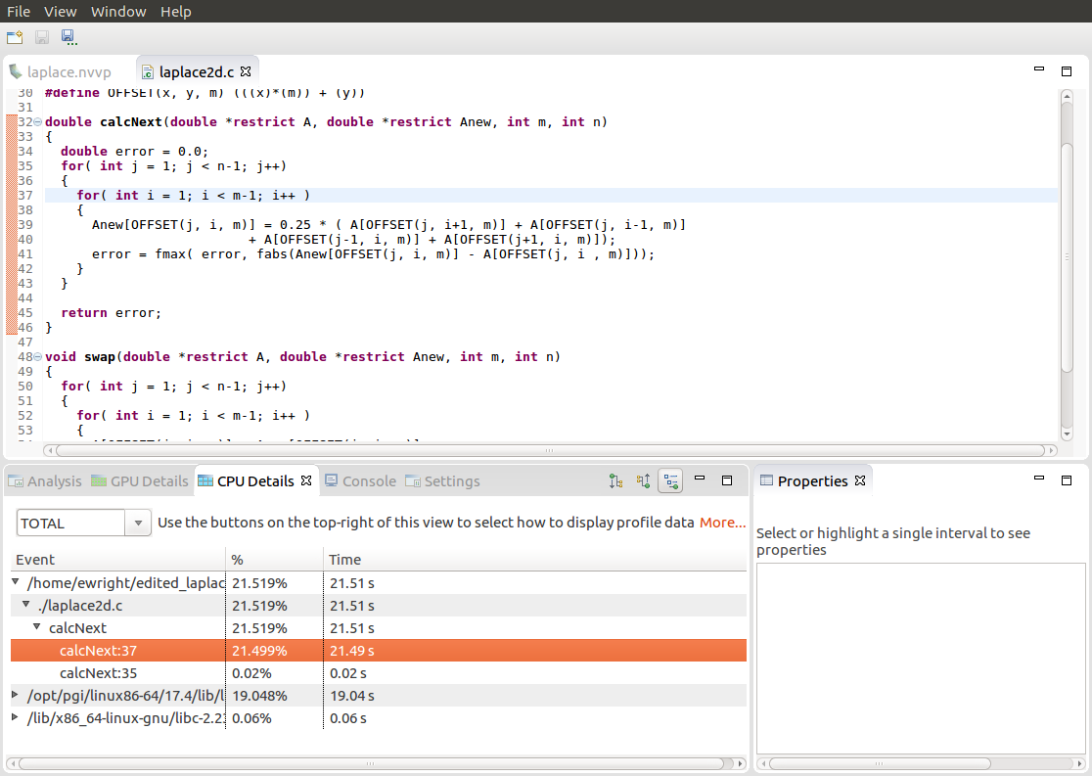
Profiling sequential code
PGPROF
We are also able to select the different elements in the CPU Details by double-clicking to open the associated source code
Here we have selected the “calcNext:37” element, which opened up our code to show the exact line (line 37) that is associated with that element
Notes:
The code is opened, and the line in question is highlighted. The code that is being detected is the code within our main loop. This is exactly what we were expecting.
Knowing this information, it makes sense why we focused on parallelizing this loop in the lab assignment, because it accounts for our entire program.

Slide 17
Profiling sequential code
Step 2: Profile Your Code
Lab Code: Laplace Heat Transfer
Obtain detailed information about how the code ran.
Total Runtime: 39.43 seconds
This can include information such as:
Total runtime
Runtime of individual routines
Hardware counters
Identify the portions of code that took the longest to run. We want to focus on these “hotspots” when parallelizing.
Notes:
Same slide as earlier – a recap. Now with the chart that matches our laplace code.

Slide 18
Profiling sequential code
Step 3: Identify Parallelism
Observe the loops contained within the identified hotspots
void pairing(int *input, int *output, int N){
for(int i = 0; i < N; i++)
output[i] = input[i*2] + input[i*2+1];
}
Are these loops parallelizable?
Can the loop iterations execute independently of each other?
Are the loops multi-dimensional, and does that make them very large?
6
3
10
7
2
4
input
Loops that are good to parallelize tend to have a lot of iterations to map to parallel hardware.
9
17
6
output
Notes:
Identifying parallelism is a bit of a manual step. Once the hotspots are identified the programmer needs to look at the loops and determine which are good candidates for directives.

Slide 19
profiling multicore code

Slide 20


Profiling multicore code
What is multicore?
CPU
Multicore refers to using a CPU with multiple computational cores as our parallel device
These cores can run independently of each other, but have shared access to memory
Loop iterations can be spread across CPU threads and can utilize SIMD/vector instructions (SSE, AVX, etc.)
Parallelizing on a multicore CPU is a good starting place, since data management is unnecessary
Notes:
The two parallel architectures we will be focusing on is multicore CPUs and GPUs. We will start with multicore CPUs because it is relatively easy to program compared to GPUs, since there’s only one memory space. In this module, we will also focus on profiling multicore code, with more GPU profiling in later modules.

Slide 21
Profiling multicore code
Using a multicore CPU with OpenACC
Host
Device
OpenACC’s generic model involves a combination of a host and a device
Host generally means a CPU, and the device is some parallel hardware
When running with a multicore CPU as our device, typically this means that our host/device will be the same
This also means that their memories will be the same
Host Memory
Device Memory
Notes:
Thinking back to our introduction of OpenACC as a general parallel model, we can now apply this model to a multicore CPU.

Slide 22
Profiling multicore code
Using a multicore CPU with OpenACC
Host/Device
OpenACC’s generic model involves a combination of a host and a device
Host generally means a CPU, and the device is some parallel hardware
When running with a multicore CPU as our device, typically this means that our host/device will be the same
This also means that their memories will be the same
Host/Device Memory
Host Memory
Notes:
Memory management for a multicore CPU target is fairly trivial. Also, achieving good performance through parallelism is relatively easy when programming for a multicore CPU. Optimizing our multicore CPU code often takes little work.

Slide 23
Profiling multicore code
Comping code for a specific parallel hardware
The ‘-ta’ flag will allow us to compile our code for a specific, target parallel hardware
‘ta’ stands for “Target Accelerator,” an accelerator being another way to refer to a parallel hardware
Our OpenACC code can be compiled for many different kinds of parallel hardware without having to change the code
$ pgcc –fast –Minfo=accel –ta=multicore laplace2d.c
calcNext:
35, Generating Multicore code
36, #pragma acc loop gang
Notes:
For right now, we will be focusing on a multicore target. Multicore is easier to program for, and serves much better as an introduction. It is still important to recognize that even if we are running our code on a multicore CPU, we could take the same code and run it on many different architectures.

Slide 24
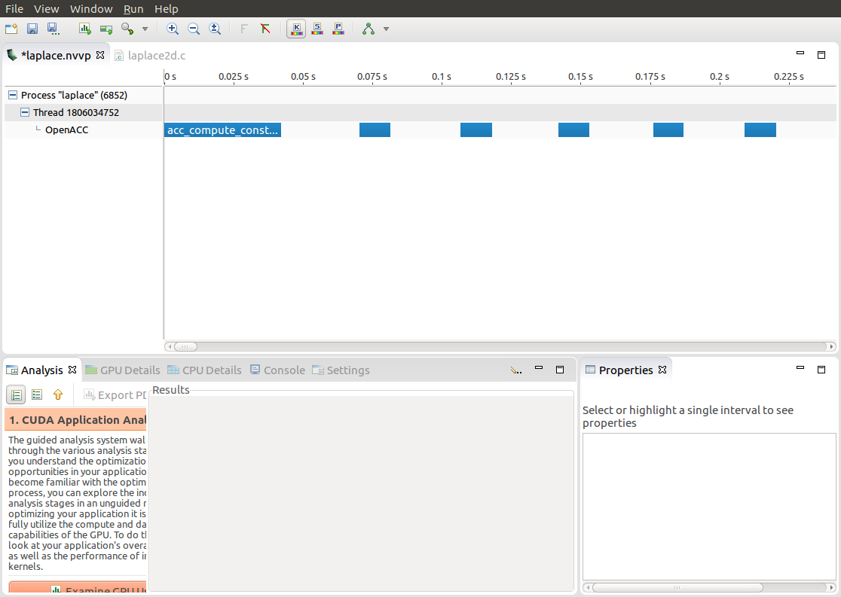
Profiling multicore code
PGPROF
The first difference we see in this multicore profile is that there is now a “timeline”
This timeline will show when our parallel hardware is being used, and how it is being used
Each of the blue bars represent a portion of our program that was run on the multicore CPU
Notes:
This is a screenshot of PGPROF when profiling the multicore code.
The main difference we see now is the inclusion of the blue timeline bar.

Slide 25
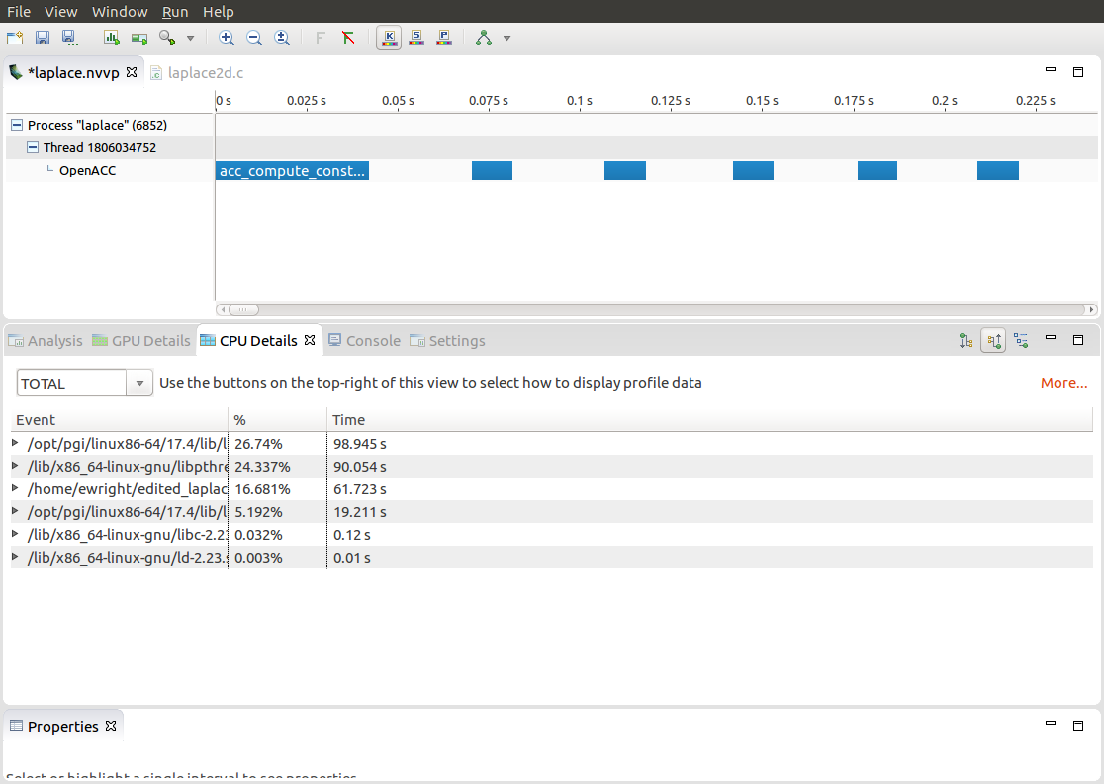
Profiling multicore code
CPU Details
Looking at our CPU Details, we can see that there is a lot more happening compared to our sequential program
For the most part, these extra details revolve around the need for the CPU cores to communicate with each other
Notes:
This is the CPU details for our multicore code. Our main function still takes up majority of the programs runtime. However, now we have additional factor. The most important being the “_mp_barrier”. This should be familiar to anyone who has done OpenMP programming.
Explanation of MP Barrier:
Thinking back to the real-world example from Module 1, when the professors and the TAs were exchanging the exams, there was a lot of communication happening. This is especially true if the graders finish grading at different times. This is essentially what is happening with MP Barrier. The CPU cores are finishing their computation at slightly different times, and have to wait for each other.
Another thing to notice is that the time taken in main is roughly the same as our sequential version. Even though our code is significantly faster. We will discuss why soon.

Slide 26
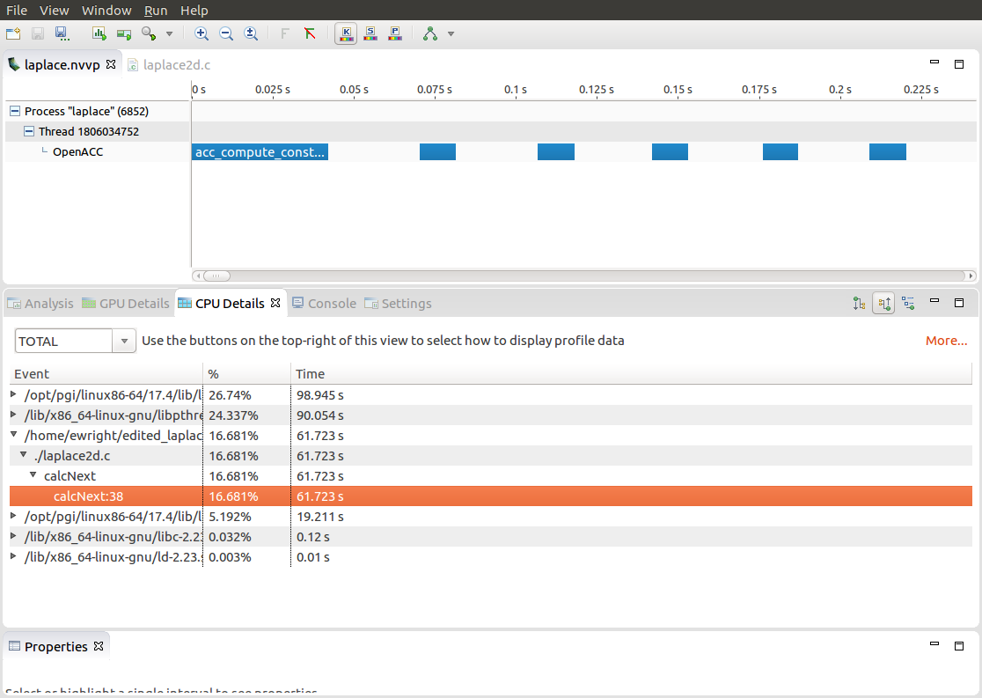
Profiling multicore code
PGPROF
Just like earlier, we see our “calcNext” function
We also see that PGPROF is reporting this function to take 61.72 seconds to run
Looking at the program now, it looks like it performs much worse than the sequential version
Notes:
Another view of what the code is spending time on.

Slide 27
Profiling multicore code
PGPROF
Notes:
Here we can see a quick comparison of our sequential code vs. our multicore code. Note the large different in the runtime of “calcNext”

Slide 28
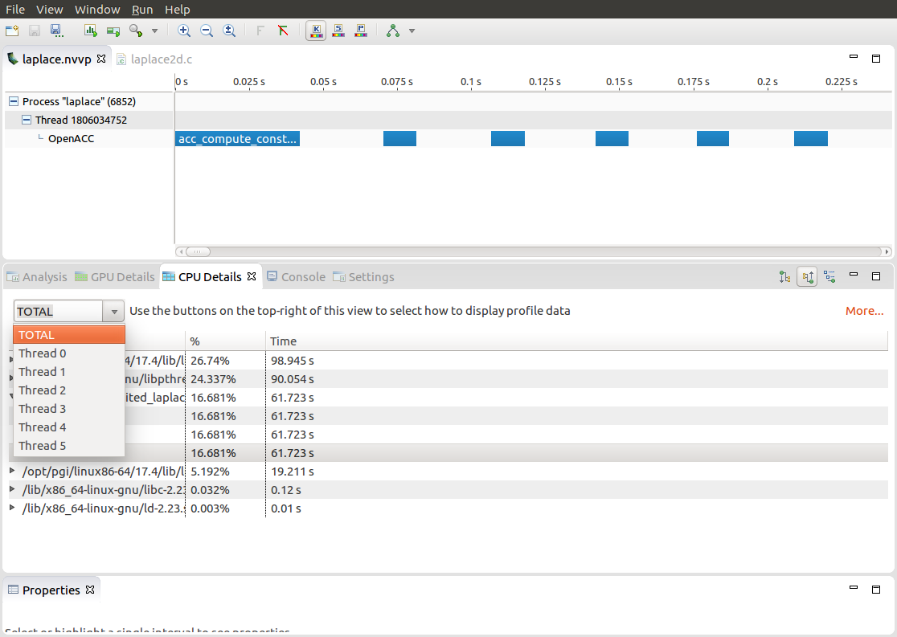
Profiling multicore code
View of all computational threads
The program is actually performing better than the sequential version
We are only looking at the “TOTAL” view, which means that PGPROF is combining information from all of our CPU cores
Notes:
When profiling multicore code, we have options of how to view it. The view we were looking at was the “TOTAL” view. This combines all CPU cores.
We also have the option to view each individual core. Each core will have slightly different runtimes.

Slide 29
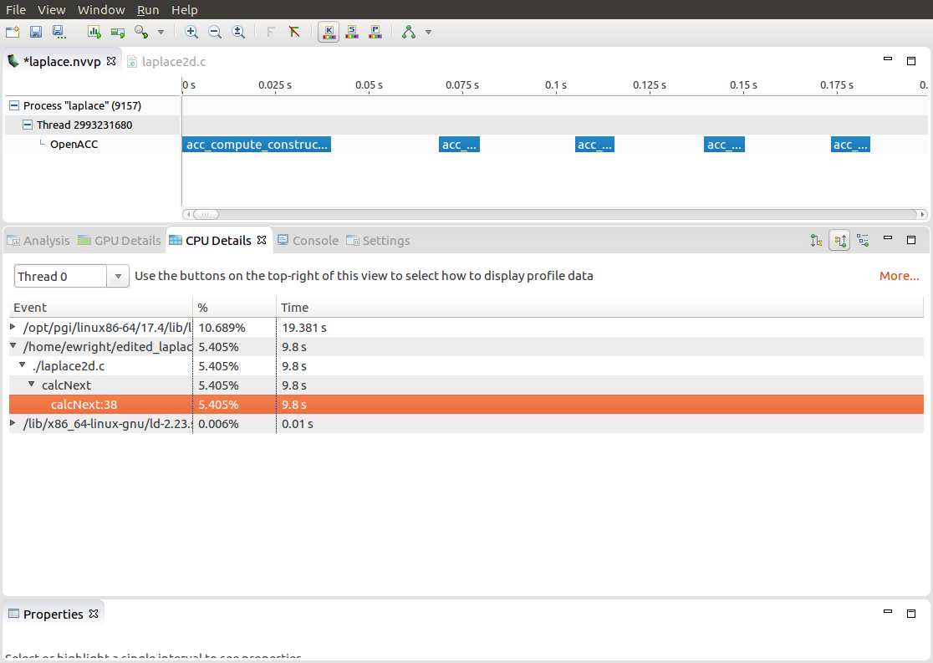
Profiling multicore code
Observing a single thread
Now we have selected to view a specific thread (for us, a thread would be a single CPU core)
We can see that this single thread only spent 9.8 seconds running calcNext
Each thread will take a similar amount of time and execute simultaneously, resulting in a faster run
Notes:
This is viewing one specific thread. Now we can see how much time each individual core in spending on the loop. When we add together the time that each core spent, it will add up to the same time as the sequential code. However, since these cores are executing at the same time, we achieve a better runtime.

Slide 30
Lab code

Slide 31
Laplace heat transfer
Introduction to lab code - visual
Very Hot
Room Temp
We will observe a simple simulation of heat distributing across a metal plate.
We will apply a consistent heat to the top of the plate.
Then, we will simulate the heat distributing across the plate.

Slide 32
Laplace heat transfer
Introduction to lab code - technical
The lab simulates a very basic 2-dimensional heat transfer problem. We have two 2-dimensional arrays, A and Anew.
A
Anew
0.0
0.0
0.0
0.0
0.0
0.0
0.0
0.0
The arrays represent a 2-dimensional, metal plate. Each element in the array is a double value that represents temperature.
0.0
0.0
0.0
0.0
0.0
0.0
0.0
0.0
0.0
0.0
0.0
0.0
0.0
0.0
0.0
0.0
We will simulate the distribution of heat until a minimum change value is achieved, or until we exceed a maximum number of iterations.
0.0
0.0
0.0
0.0
0.0
0.0
0.0
0.0
Notes:
Our code has two 2-dimensional arrays, A and Anew. These arrays contain double values, and these doubles represent a temperature. The 2-D array itself represents a flat metal plate, and each element is some portion of that plate that contains a temperature.
We initialize our arrays be “heating” one side of the plate. So, on the top side of the plate, we set all of the values to 1.0.
Our calcNext function will look at each of the inner positions of the plate, and update its temperature based on its neighbors. The temperature will be set to the average temperature of its four neighbors.
Then lastly, the contents of Anew will be copied back to A. Then calcNext will be called again, until our answer is computed.

Slide 33
Laplace heat transfer
Introduction to lab code - technical
We initialize the top row to be a temperature of 1.0
A
Anew
The calcNext function will iterate through all of the inner elements of array A, and update the corresponding elements in Anew
0.0
1.0
0.0
1.0
0.0
1.0
0.0
1.0
0.0
1.0
0.0
1.0
0.0
1.0
0.0
1.0
0.0
0.0
0.0
0.0
0.0
0.25
0.25
0.0
0.0
0.0
0.0
0.0
0.0
0.0
0.0
We will take the average of the neighboring cells, and record it in Anew.
0.0
0.0
0.0
0.0
0.0
0.0
0.0
0.0
0.0
0.0
0.0
0.0
0.0
0.0
0.0
The swap function will copy the contents of Anew to A
Notes:
Our code has two 2-dimensional arrays, A and Anew. These arrays contain double values, and these doubles represent a temperature. The 2-D array itself represents a flat metal plate, and each element is some portion of that plate that contains a temperature.
We initialize our arrays be “heating” one side of the plate. So, on the top side of the plate, we set all of the values to 1.0.
Our calcNext function will look at each of the inner positions of the plate, and update its temperature based on its neighbors. The temperature will be set to the average temperature of its four neighbors.
Then lastly, the contents of Anew will be copied back to A. Then calcNext will be called again, until our answer is computed.

Slide 34
Laplace heat transfer
Introduction to lab code
A
Anew
1.0
1.0
1.0
1.0
1.0
1.0
1.0
1.0
0.0
0.25
0.25
0.0
0.0
0.25
0.25
0.0
0.0
0.0
0.0
0.0
0.0
0.0
0.0
0.0
0.0
0.0
0.0
0.0
0.0
0.0
0.0
0.0
The swap function will copy the contents of Anew to A

Slide 35
KEY concepts
In this module we discussed…
Compiling sequential and parallel code
CPU profiling for sequential and parallel execution
Specifics of our Laplace Heat Transfer lab code

Slide 36
Lab Goals
In this lab you will do the following…
Build and run the example code using the PGI compiler
Use PGProf to understand where the program spends its time

Slide 37
THANK YOU

